Slide 1

G2M Case Study
Virtual Internship
21-Apr-2023

Slide 2
Background –G2M(cab industry) case study
XYZ is a private equity firm in US. Due to remarkable growth in the Cab Industry in last few years and multiple key players in the market, it is planning for an investment in Cab industry.
Objective : Enabling XYZ company to invest in the right company by analyzing and visualizing data more efficiently.
DATA WAS DIVIDED THREE PARTS :
1.UNDERSTAND DATA CLEARLY
2.BASED ON DATASET TO FIND A COMPANY WHICH HAVE MORE PROFIT
3. RECOMMEND THE COMPANY WHICH ARE SUITABLE TO INVEST

Slide 3
Data Exploration
14 Features
Timeframe of the data: 2016-01-31 to 2018-12-31
Total data points :439585
Cab_Data.csv
Customer_ID.csv
Transaction_ID.csv
City.csv
Final cab data

Slide 4
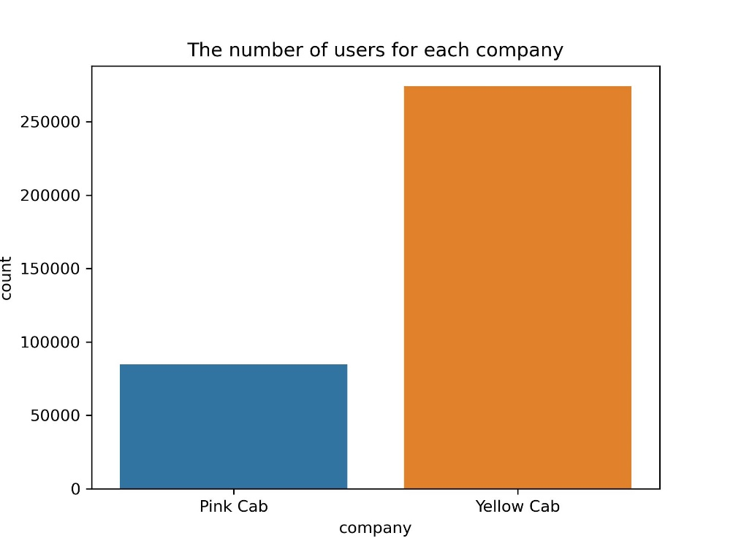
Number of customers by Companies
Yellow Cab taxi company users are almost 3 times more than Pink Cab users

Slide 5
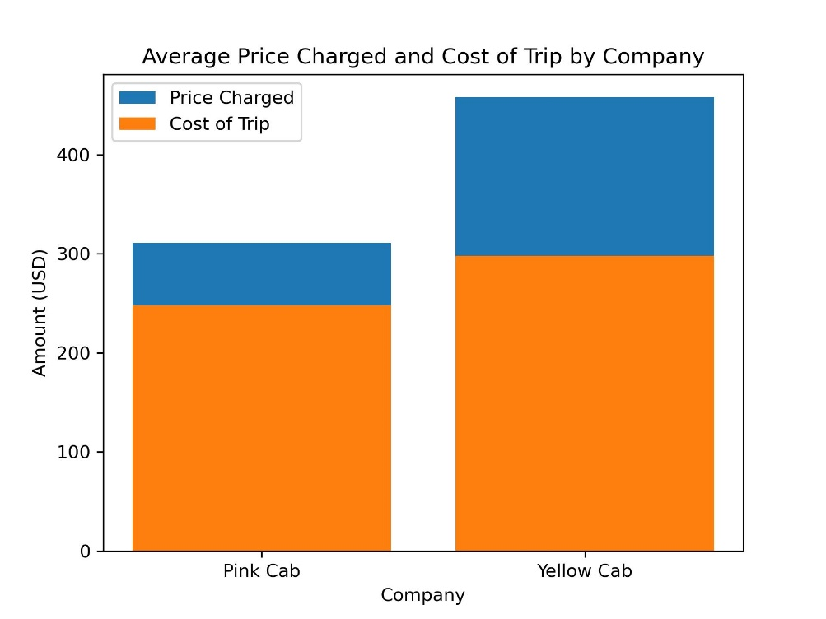
AVERAGE Price Charged and Cost of Trip by Company
Average price charged and cost of trip are higher in Yellow Cab Taxi Company.

Slide 6
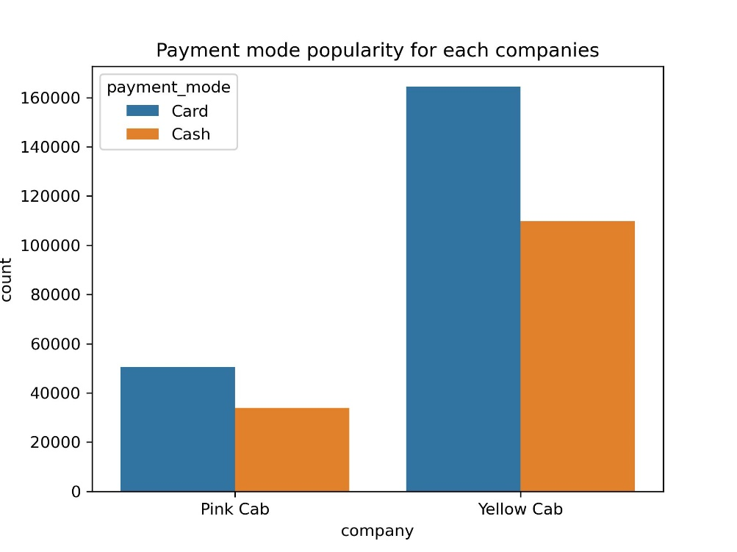
Payment Mode Popularity
Customers of both company prefer to pay by card rather than cash

Slide 7
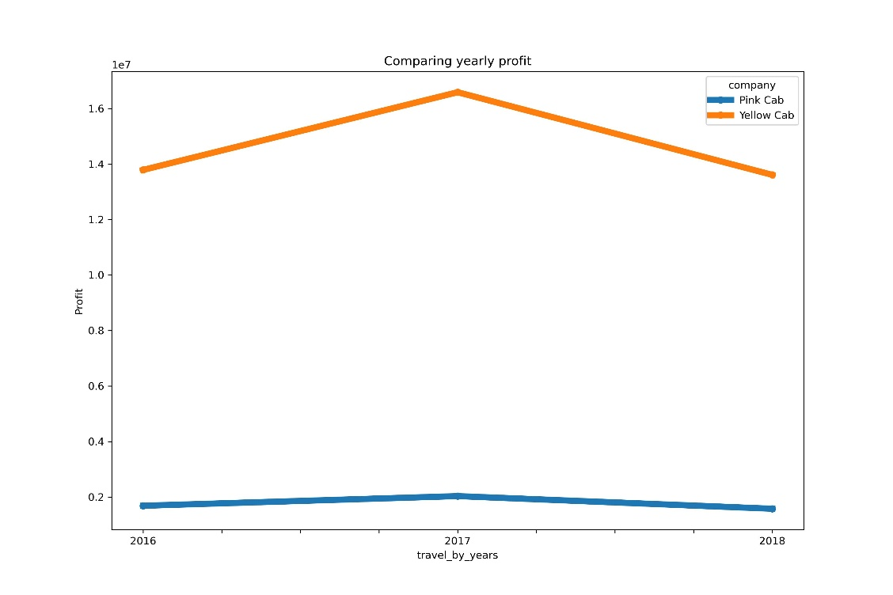
Yearly profit by Companies between 2016 and 2018
Yellow Cab has more profit than Pink Cab between 2016 and 2018

Slide 8
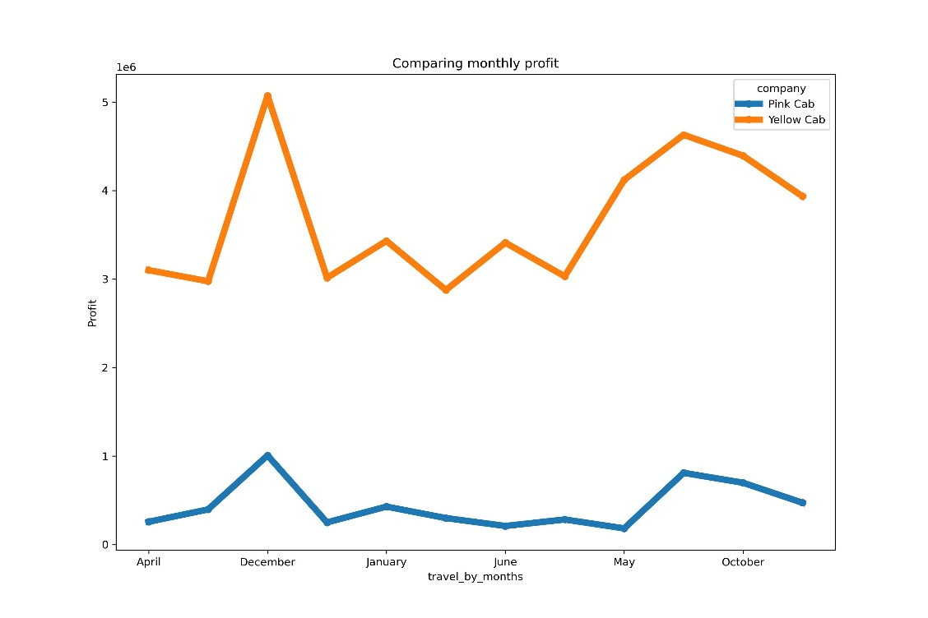
montly profit by Companies between 2016 and 2018
Both companies have more customers in December

Slide 9
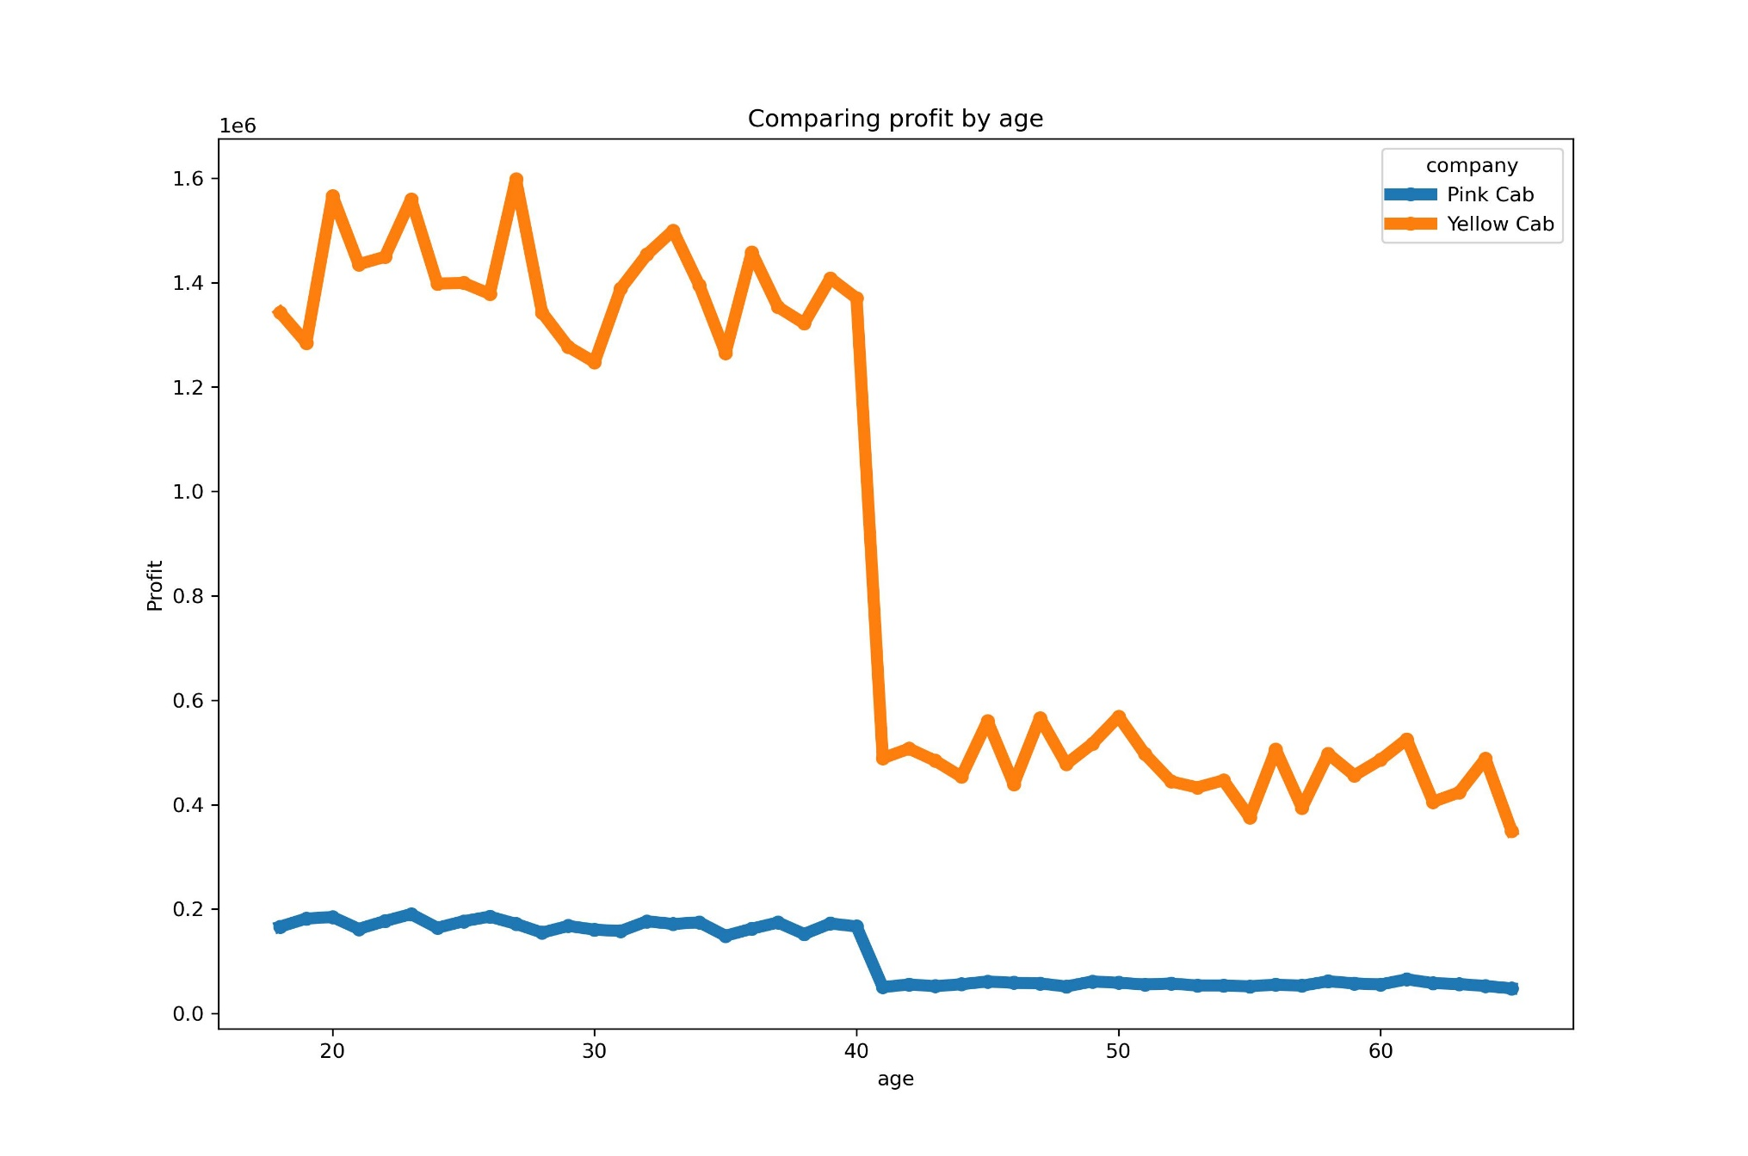
profit of Companies by customers age between 2016 and 2018
Customers are not keen on using taxi service who are older than 40

Slide 10
Recommendations
1.Yellow Cab Taxi Company's average price charged and cost of trip is higher than Pink Cab.
2.Customers prefer to card payment model rather than cash.
3.Taxi service price is higher in New York than other cities
4.Yellow Cab monthly and yearly profit are higher than Pink Cab.
5.Yellow Cab has more customers than Pink Cab.
Based on these data, we can say that the Yellow Cab offers more advantages for investment.

